Slide 1




Chapter 2
Secure Design Principles and Practices
Secure Software Engineering
Dr. Mohammed Tawfik

Slide 2

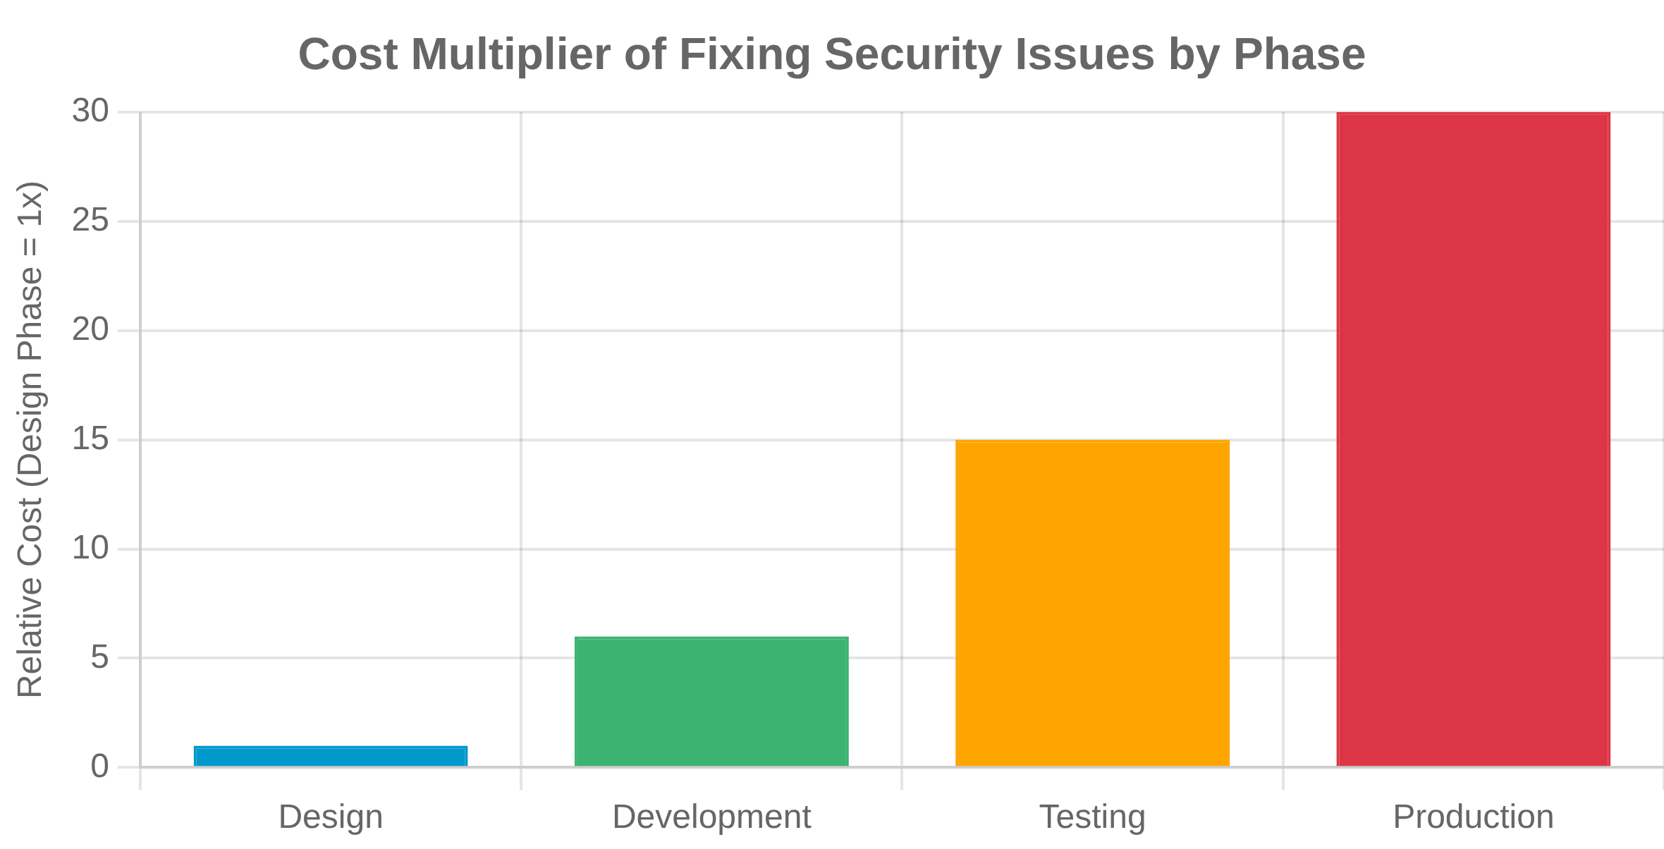




Introduction to Secure Design
Why Secure Design Matters
30x more
Security issues identified late in development can cost
to fix than those caught in the design phase.
Shifting Left: Early Security Integration
"Shifting left" means integrating security considerations
earlier in the software development lifecycle.
Key Concept
Security is most effective and cost-efficient when built in from the
beginning, not added as an afterthought.
Benefits of Secure Design
Reduced vulnerability remediation costs
Improved compliance with regulations
Enhanced customer trust and confidence
Decreased likelihood of security breaches
2

Slide 3

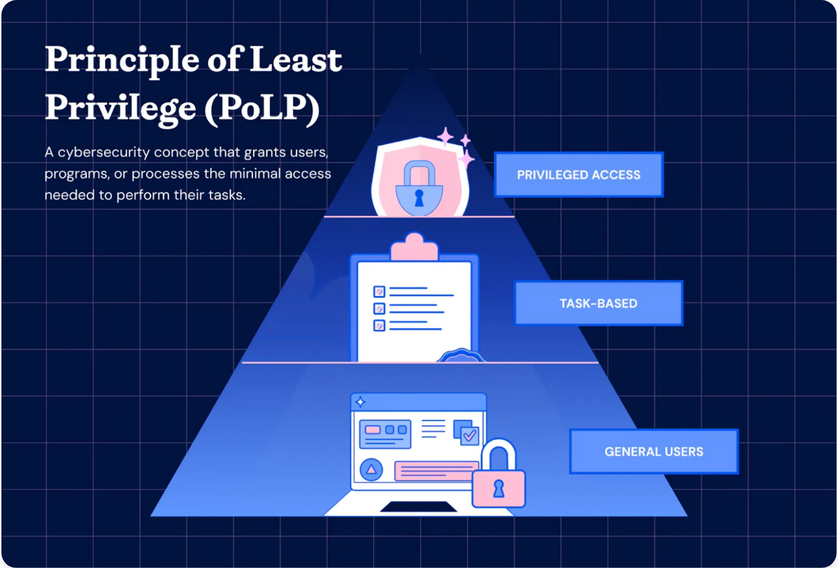






Principle of Least Privilege
Definition
A user, process, or program should be given
only the minimum privileges
necessary to complete their task.
Why It Matters
Limits potential damage from accidents or errors
Reduces attack surface for malicious actors
Minimizes the "blast radius" of security incidents
Software Development Examples
Supports compliance with security regulations
Application Permissions
Implementation Challenges
Mobile apps requesting only necessary permissions (camera, location, contacts) instead of all possible permissions.
Balancing security with usability and productivity
Managing privilege escalation for legitimate needs
Database Access
Database users granted read-only access to specific tables rather than admin privileges to the entire database.
Container Security
Containers running with non-root users and minimal system capabilities.
3

Slide 4

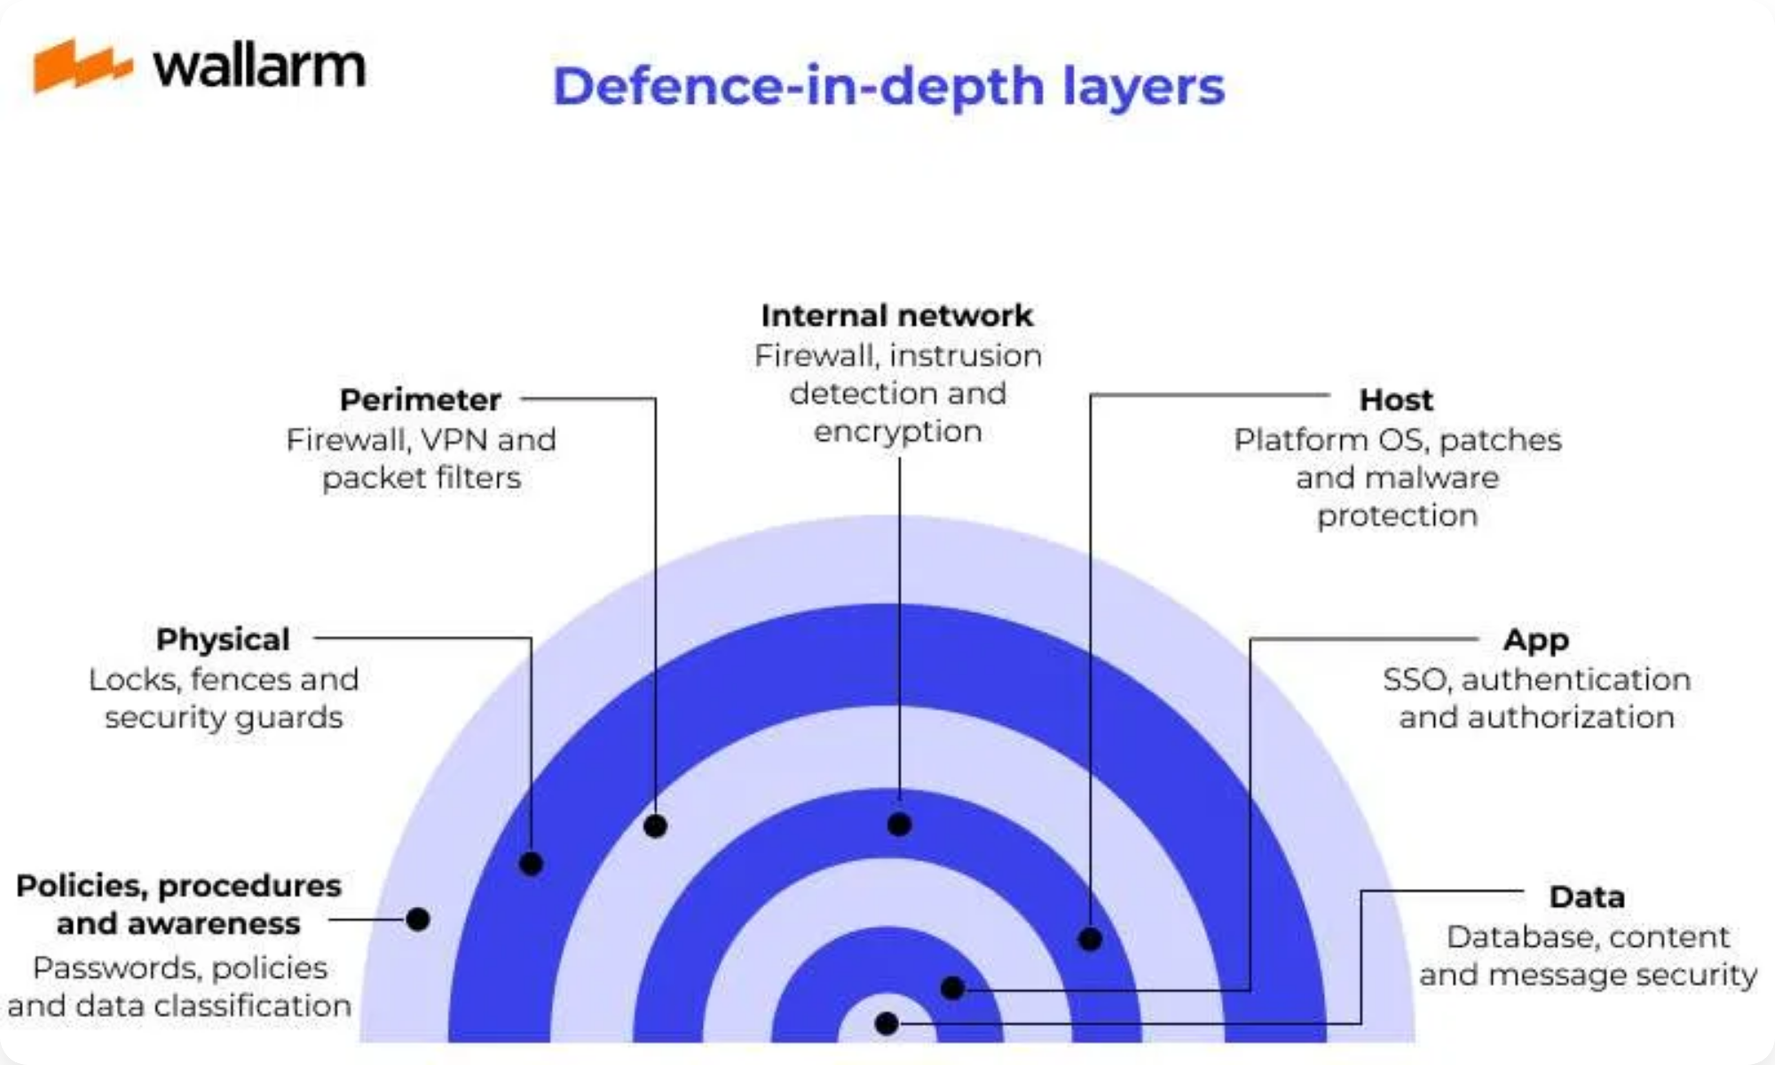







Principle of Defense in Depth
A layered security approach where multiple defensive mechanisms are used to protect valuable data and information.
Core Concept
If one security control fails, others are in place to prevent
or limit an attack.
Security Layers in Software
Benefits
Network Layer
Provides multiple opportunities to detect and stop attacks
Firewalls, IDS/IPS, network segmentation, VPNs, API gateways
Compensates for vulnerabilities in individual layers
Increases the cost and complexity for attackers
Application Layer
Buys time for incident response teams to react
Input validation, authentication, authorization, encryption, secure coding practices
Implementation Challenges
Balancing security depth with performance and usability
Data Layer
Avoiding false sense of security from multiple layers
Encryption at rest, access controls, data masking, integrity checks
4

Slide 5

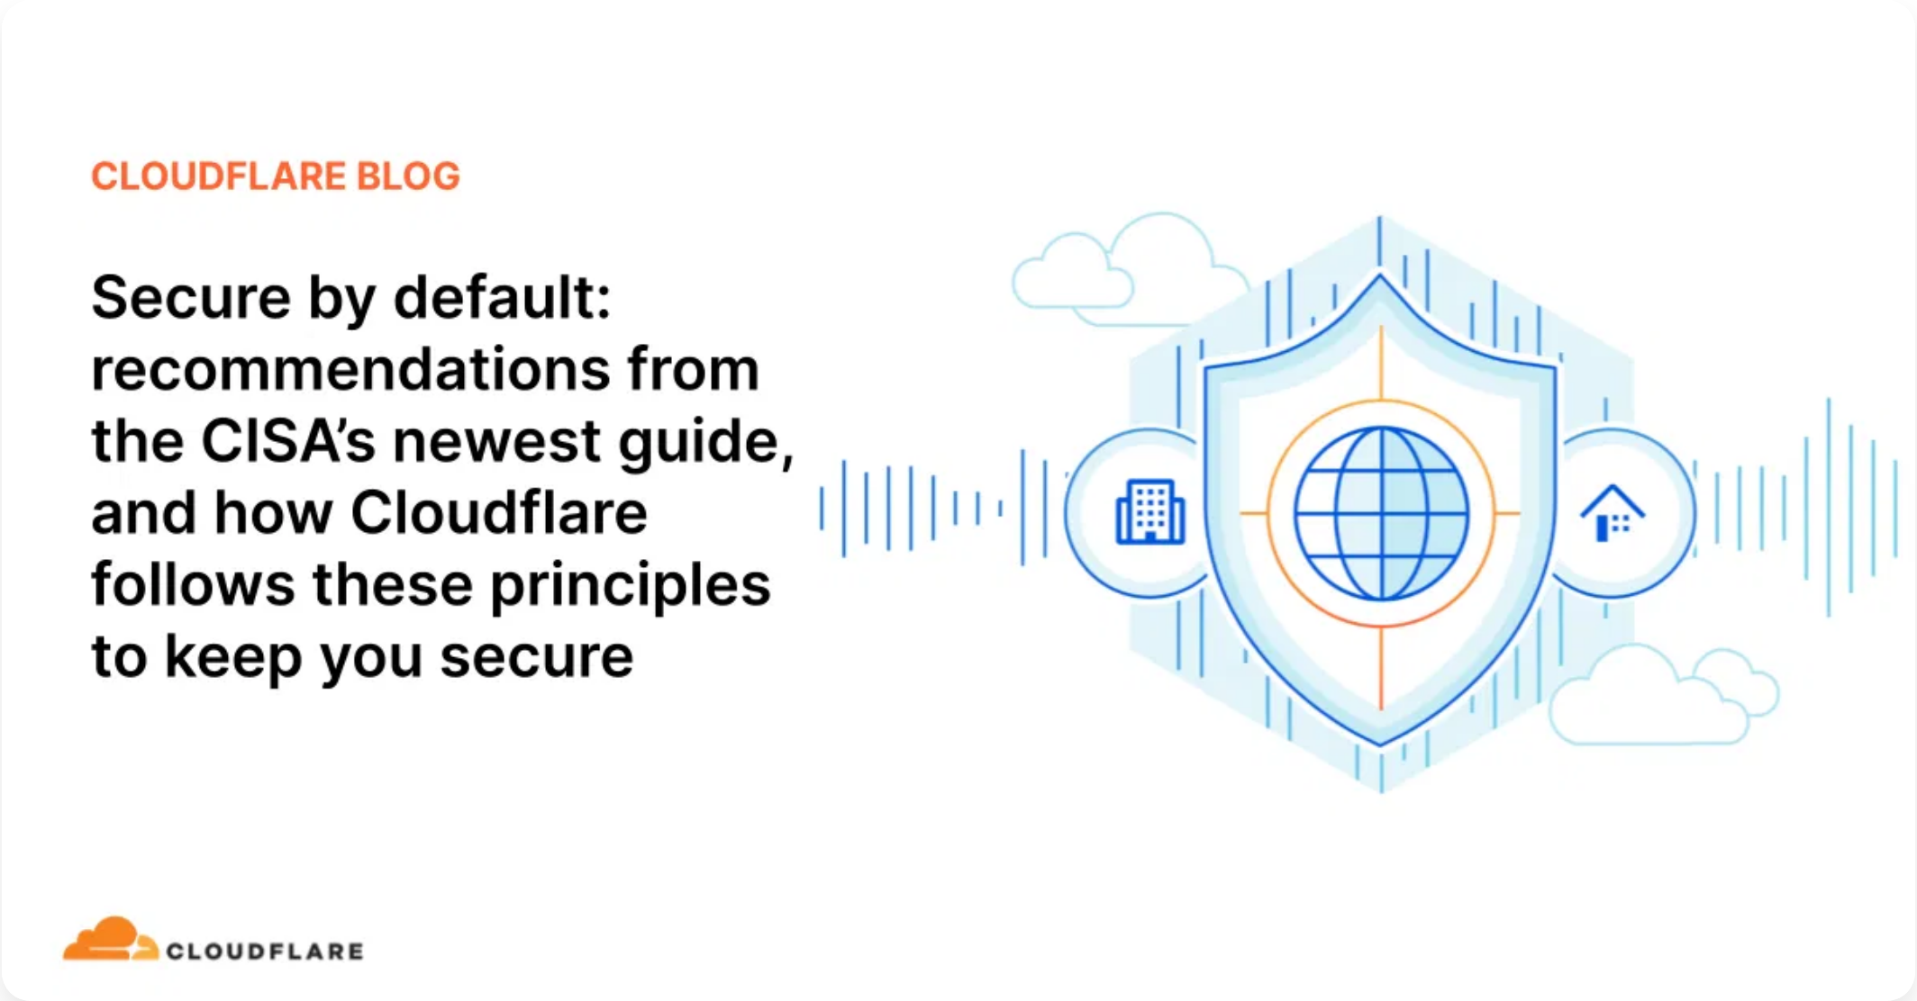

Principle of Secure Defaults
Definition
Systems should be
secure out-of-the-box
without requiring users to take
explicit actions to enable security features.
Core Concepts
Security should be the default state
Examples in Software Development
Users shouldn't need security expertise to be protected
Insecure Default
Secure Default
Opt-out rather than opt-in for security features
Deny by default, permit by exception
Default admin passwords
Forced password change on first login
Implementation Challenges
All network ports open
All ports closed except those explicitly needed
Balancing security with usability and convenience
Automatic execution of scripts
Script execution disabled by default
Determining appropriate defaults for different contexts
Unencrypted communications
Encryption enabled by default (HTTPS, TLS)
Private access with explicit sharing
Public access to resources
5

Slide 6

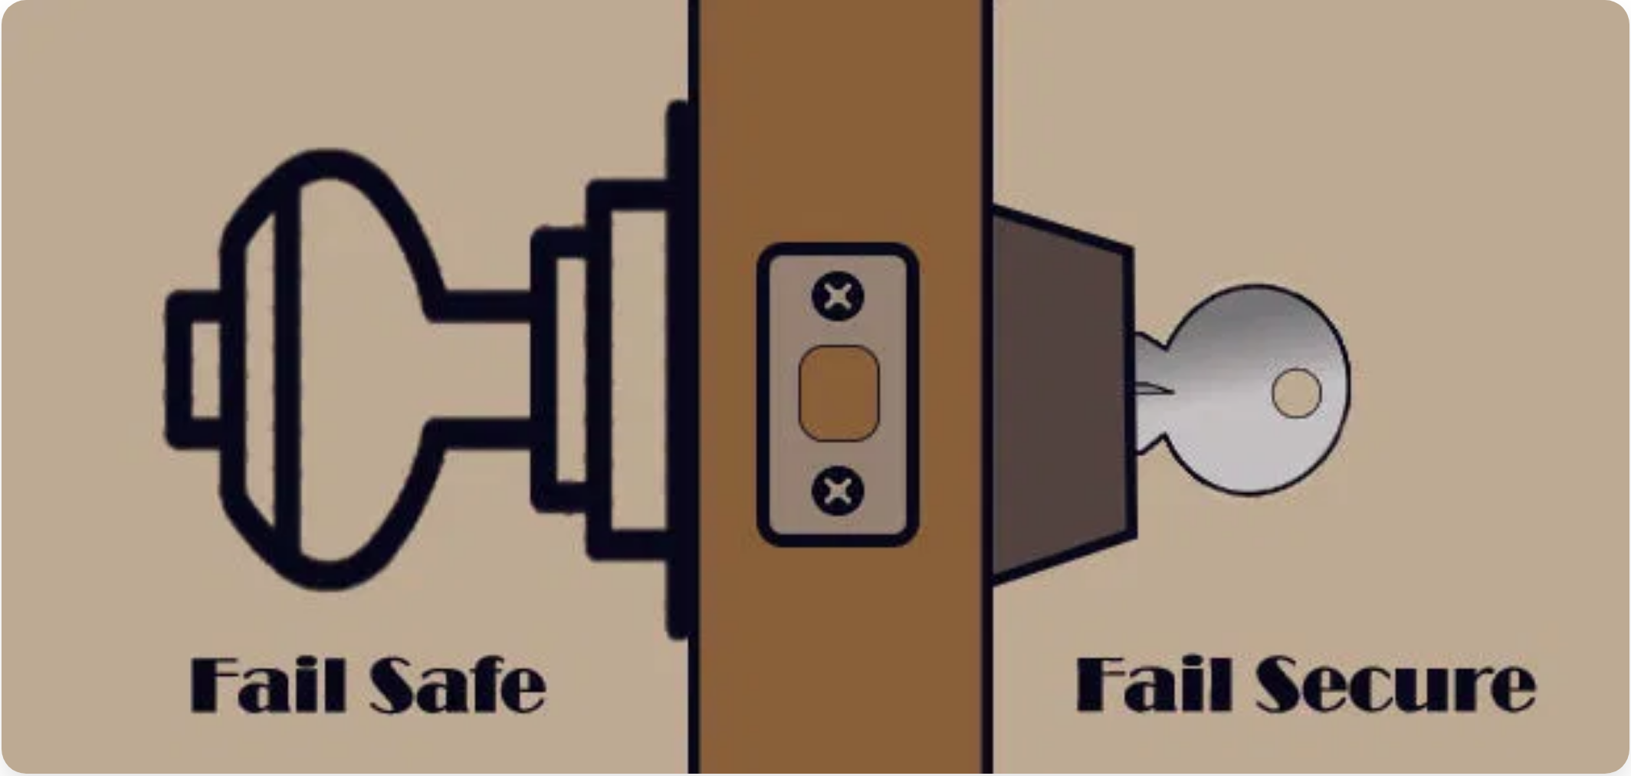







Principle of Fail Securely
Definition
When a system fails, it should
default to a secure state
rather than
exposing sensitive information or allowing unauthorized access.
Core Concepts
Default to denial of access when systems fail
Prevent information leakage in error messages
Maintain secure state during recovery processes
Fail-Safe vs. Fail-Secure Comparison
Log failures appropriately for analysis
Common Mistakes
Fail-Safe
Fail-Secure
Prioritizes availability and operations
Prioritizes security and protection
Detailed error messages revealing implementation details
Disabling security controls during failure recovery
Defaults to open/accessible state
Defaults to closed/restricted state
Example: Fire door unlocks when power fails
Example: Vault door remains locked when power fails
Implementation Example
A payment processing system that cancels transactions and notifies administrators when the fraud detection service is unavailable, rather than allowing transactions to proceed unchecked.
6

Slide 7

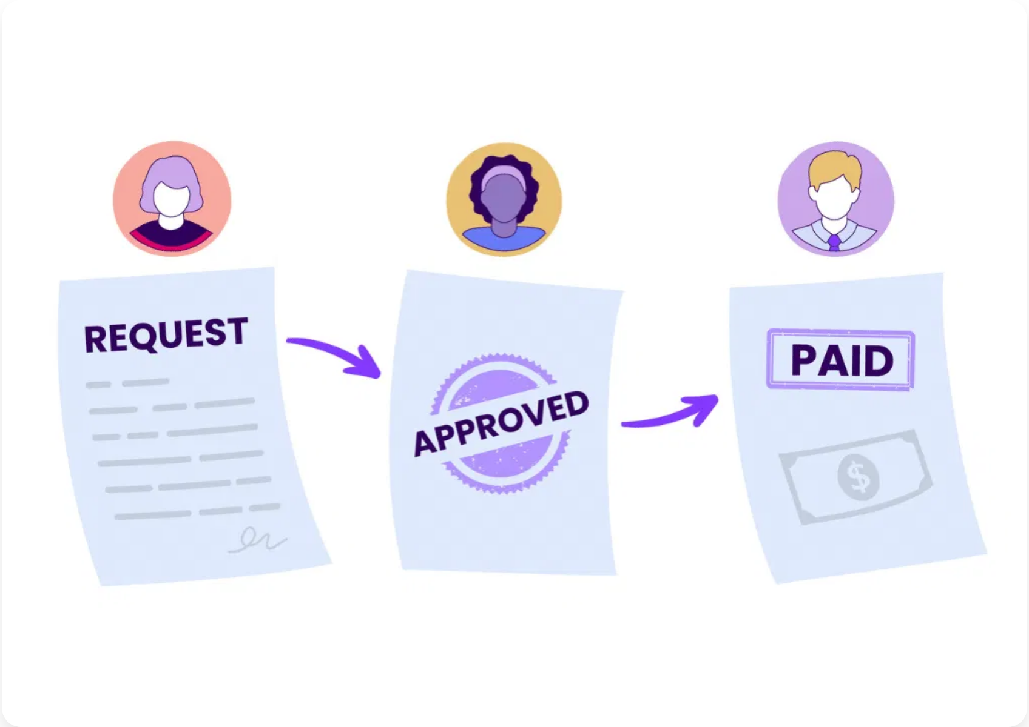







Principle of Separation of Duties
Definition
Critical tasks are divided among multiple people to prevent fraud, errors, and conflicts of interest. No single individual should control all aspects of a critical process.
Software Development Examples
Core Components
Code Review Process
Authorization
: Approving transactions or changes
Developers cannot approve their own code changes; separate reviewers must approve before code is merged.
Custody
: Handling assets or implementing changes
Production Deployment
Record Keeping
: Documenting transactions or changes
Different teams handle development, testing, and production deployment to ensure multiple checkpoints.
Reconciliation
: Verifying that actions were performed correctly
Admin Access Control
Benefits
System administrators have different access levels; no single admin has complete control over all systems.
Reduces risk of fraud and errors
Improves detection of malicious activities
Enhances compliance with regulations
7

Slide 8
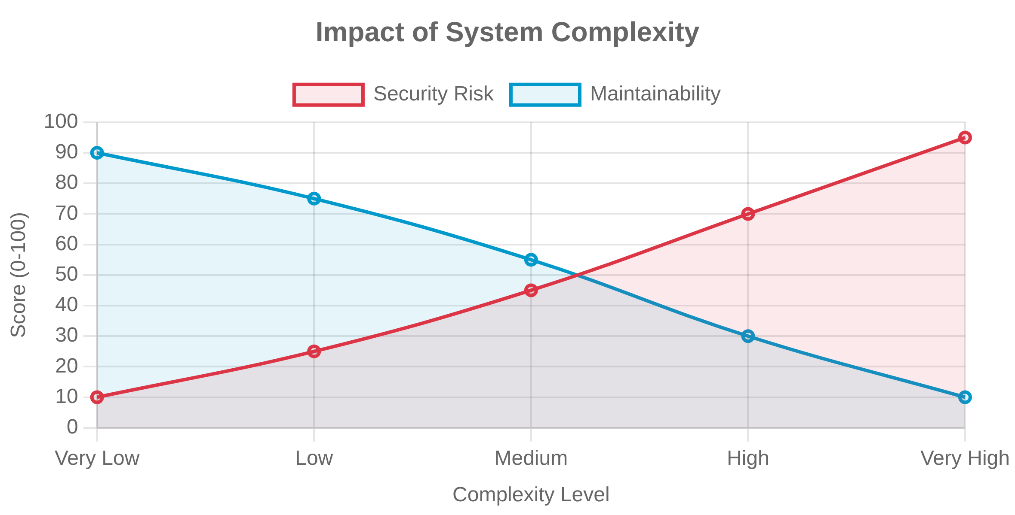




Principle of Simplicity
Definition
Security designs should be as simple as possible, avoiding unnecessary complexity that can introduce vulnerabilities.
Why Simplicity Matters
Easier to understand and review
Fewer components means fewer potential vulnerabilities
Implementation Strategies
Simpler to test and verify security properties
More maintainable over time
Modular Design
The Complexity Challenge
Break complex systems into well-defined, independent modules with clear interfaces and responsibilities.
"Complexity is the enemy of security" - Bruce Schneier
Each new feature, component, or integration point
Feature Minimization
increases attack surface
Eliminate unnecessary features and code paths that increase complexity without adding value.
Code Review Focus
Prioritize simplicity in code reviews; question complex solutions and encourage simpler alternatives.
8

Slide 9

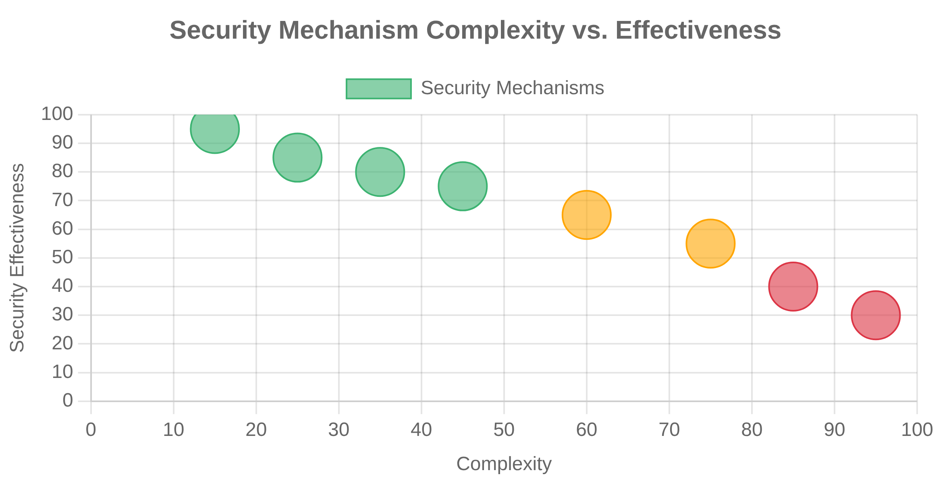





Principle of Economy of Mechanism
Definition
Security mechanisms should be as simple, small, and straightforward as possible while still meeting security requirements.
Related to Simplicity, But Different
While simplicity focuses on the overall system design,
economy of mechanism specifically targets the security
controls themselves.
Key Benefits
Easier to analyze for security flaws
Implementation Examples
More likely to be implemented correctly
Complex Approach
Economic Approach
Simpler to test thoroughly
Custom encryption algorithm with multiple modes and proprietary extensions
Standard, well-vetted encryption algorithm with simple configuration
Reduces potential for unexpected interactions
Historical Perspective
Complex Approach
Economic Approach
"Keep it simple, stupid" (KISS) principle applied to security mechanisms. Originated from Saltzer and Schroeder's 1975 paper on the protection of information in computer systems.
Multi-layered access control with numerous exceptions and special cases
Role-based access control with clear, consistent permission model
9

Slide 10
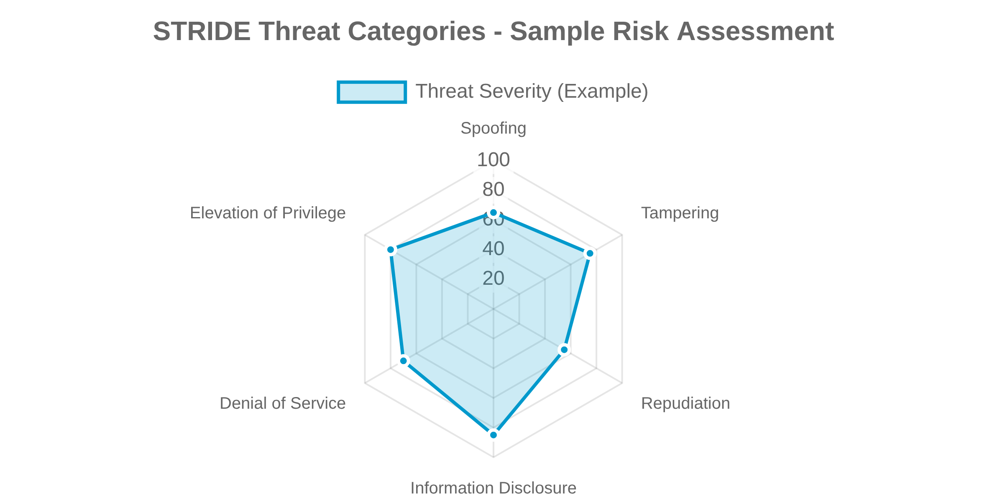



Threat Modeling in Design
Definition
A structured approach to identifying, quantifying, and addressing security risks associated with a system or application during the design phase.
The Threat Modeling Process
1
Identify Assets
: Determine what needs protection
2
Create Architecture Overview
: Document system components and data
flows
3
Decompose Application
: Break down into functional components
4
Identify Threats
: Use methodologies like STRIDE to find potential
A
ttack
S
imulation and
T
hreat
A
nalysis - Risk-centric, attacker-
threats
focused approach
5
Document Threats
: Create threat profile with risk ratings
6
Rate Threats
: Prioritize based on impact and likelihood
STIDE
7
Categorizes threats as:
S
poofing,
T
ampering,
R
epudiation,
I
nformation
Mitigate Risks
: Develop countermeasures for each threat
disclosure,
D
enial of service,
E
levation of privilege
DREAD
Risk assessment model:
D
amage,
R
eproducibility,
E
xploitability,
A
ffected
users,
D
iscoverability
P
10

Slide 11
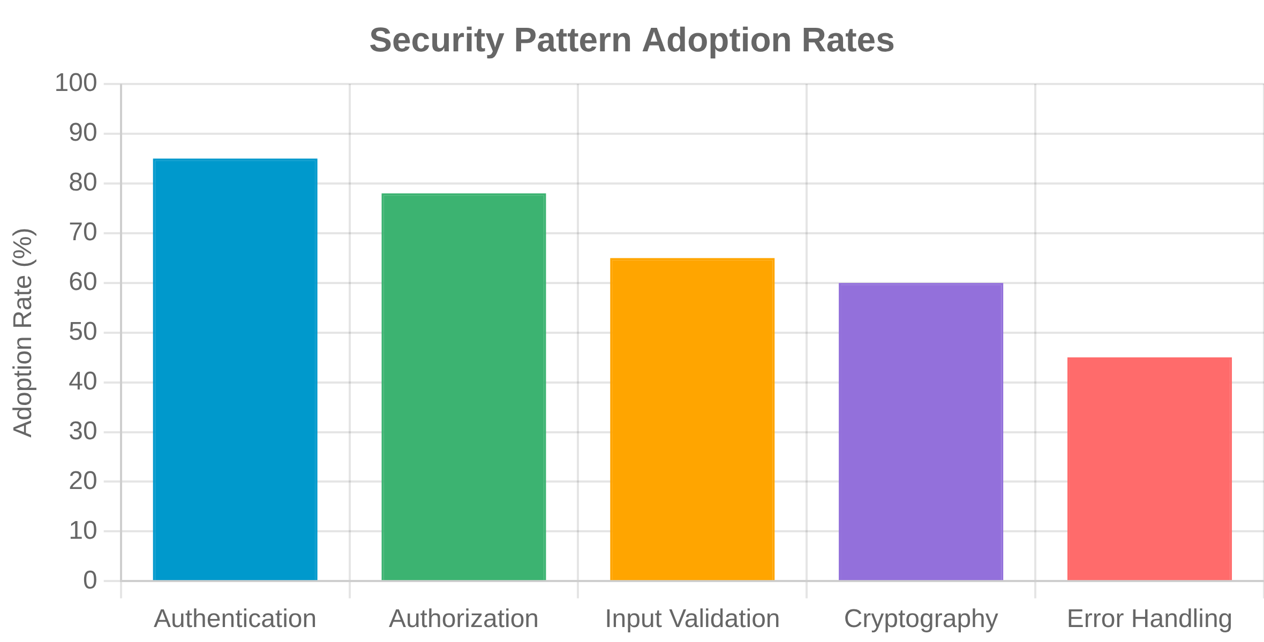





Secure Design Patterns
Definition
Reusable solutions to common security problems that can be applied across different software systems.
Pattern Categories
Authentication & Authorization
: Verifying identity and controlling
access
Common Security Patterns
Input Validation & Output Encoding
: Preventing injection attacks
Secure Session Management
Cryptographic
: Protecting data confidentiality and integrity
Generates secure session tokens, implements proper timeout mechanisms, and protects against session fixation attacks.
Secure Communication
: Protecting data in transit
Benefits
Gatekeeper Pattern
Leverage proven security solutions
Centralizes access control decisions through a single component that validates all requests before allowing access to protected resources.
Reduce design and implementation errors
Establish common security vocabulary
Input Validator Chain
Applies multiple validation rules in sequence to ensure input meets all security requirements before processing.
11

Slide 12

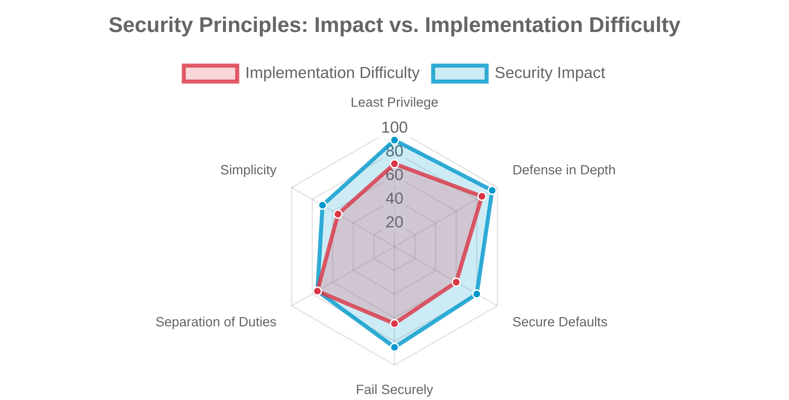





Summary and Next Steps
Key Takeaway
Secure design principles provide a foundation for building security into software from the beginning, reducing vulnerabilities and improving overall security posture.
Core Principles Covered
Principle of Least Privilege
Minimum access rights necessary to perform tasks
Applying Secure Design Principles
Defense in Depth
Multiple layers of security controls
Integrate principles early in the SDLC
Secure Defaults
Use threat modeling to identify security requirements
Systems secure out-of-the-box
Fail Securely
Apply secure design patterns to common problems
Default to secure state during failures
Validate security through testing and code review
Separation of Duties
Dividing critical tasks among multiple individuals
Coming Up in Chapter 3
Simplicity
Secure Coding Practices
Keeping designs as simple as possible
Common Vulnerabilities and Mitigations
Security Testing Methodologies
Secure DevOps Integration
12

Slide 13

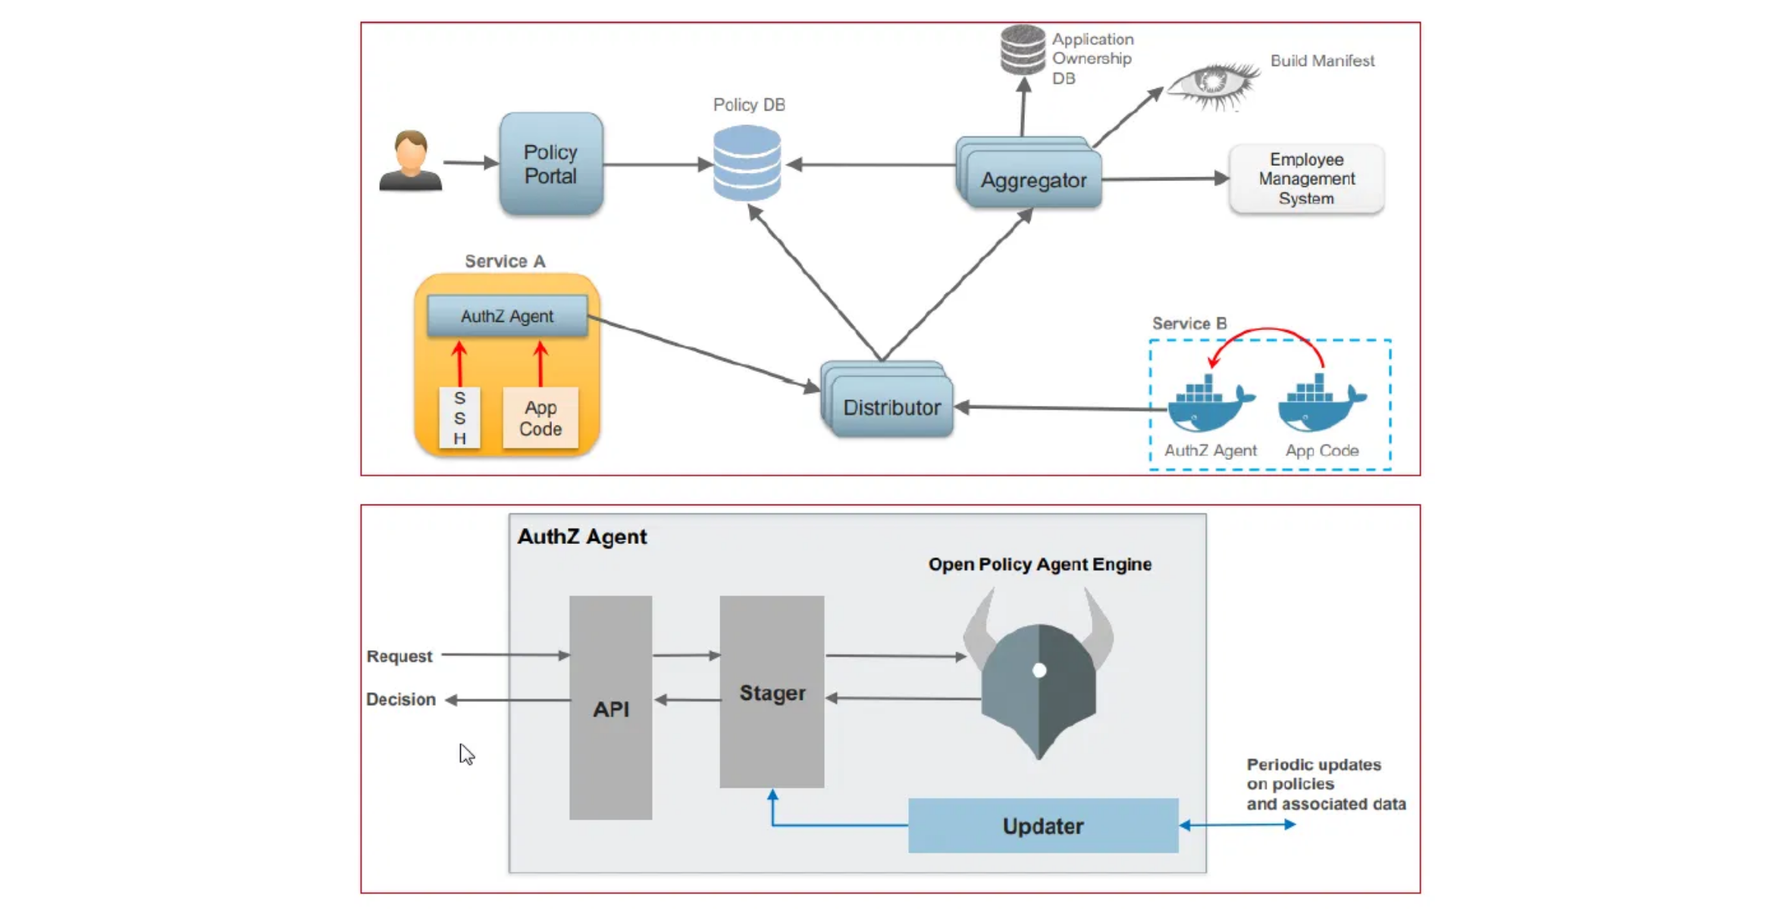



Secure Microservices Architecture
Definition
A secure microservices architecture implements security controls at multiple levels to protect individual services, their communications, and the overall system.
Security Challenges
Increased Attack Surface
: More network communication and
endpoints
Service-to-Service Authentication
: Managing identities across
services
Security Solutions
Secrets Management
: Distributing and protecting credentials
API Gateway
: Centralized authentication, authorization, and
monitoring
Consistent Security Policies
: Enforcing across distributed services
Service Mesh
: Secure service-to-service communication with mTLS
Defense in Depth
: Security at network, service, and data levels
Vault Systems
: Centralized secrets management
13

Slide 14



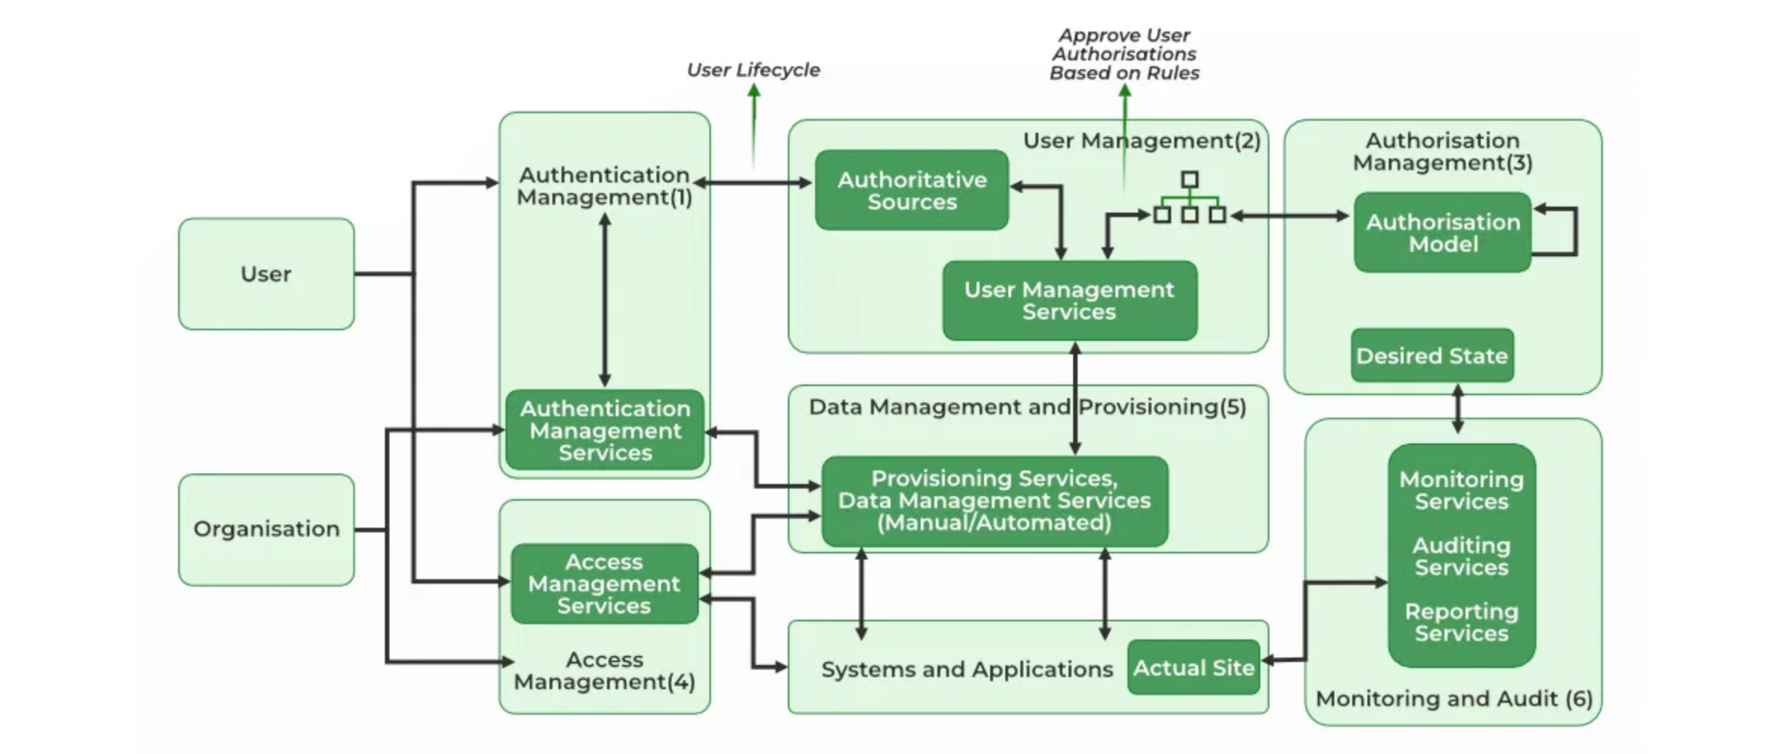
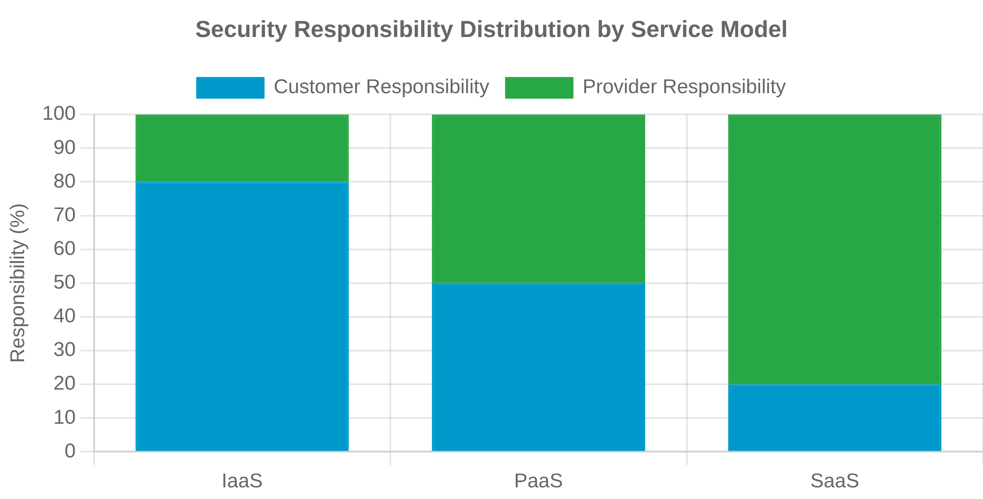

Cloud Security Architecture
Definition
Key Security Components
A framework of security controls, policies, and technologies designed to protect data, applications, and infrastructure in cloud environments.
Identity and Access Management (IAM)
: Controls who can access
what resources
Shared Responsibility Model
Network Security
: VPCs, security groups, firewalls, and encryption
Security responsibilities are divided between the cloud
provider and customer, varying by service model (IaaS, PaaS,
SaaS).
Data Protection
: Encryption at rest and in transit, key management
Monitoring and Detection
: Logging, threat detection, and incident
Security Design Principles
response
Zero Trust Architecture
: "Never trust, always verify"
Compliance and Governance
: Policies, standards, and auditing
Defense in Depth
: Multiple security layers
Least Privilege
: Minimal access rights
Automation
: Security as code
14

Slide 15

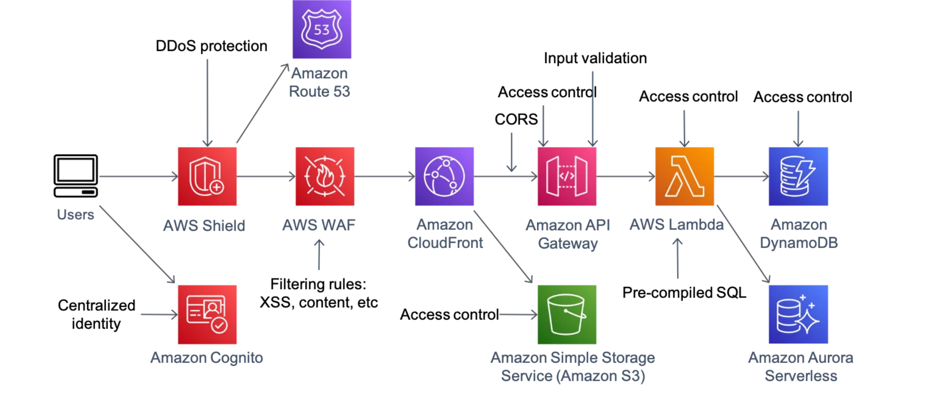







API Security
Definition
The practice of protecting APIs from threats and vulnerabilities through authentication, authorization, encryption, and other security controls.
Common API Vulnerabilities
Broken Authentication
: Weak or missing authentication
mechanisms
Broken Authorization
: Improper access control to resources
Security Controls
Injection Attacks
: SQL, NoSQL, command injection
OAuth 2.0 & JWT
: Secure token-based authentication and
authorization
Excessive Data Exposure
: Returning sensitive data in responses
API Gateway
: Authentication, rate limiting, logging, and
monitoring
Rate Limiting Absence
: No protection against abuse or DoS
Input Validation
: Schema validation and sanitization
API Specifications
: OpenAPI/Swagger for documentation and
security
TLS Encryption
: Protect data in transit
15

Slide 16









Input Validation
Implementation Examples
Definition
Insecure Approach
The process of verifying that input data meets specified criteria before processing it, helping to prevent injection attacks and other security vulnerabilities.
// No validation
function processInput(input) {
executeQuery("SELECT * FROM users WHERE id = " + input);
}
Validation Strategies
Whitelist Validation
Secure Approach
Accept only
// With validation
function processInput(input) {
if (!/^\d+$/.test(input)) {
throw new Error("Invalid input");
}
executeQuery("SELECT * FROM users WHERE id = " + input);
}
known good
Schema Validation
input
Validate
Blacklist Validation
against a
Key Principles
formal
known bad
schema
input (less
Validate on server-side (client-side is easily bypassed)
Type Checking
(JSON
Reject
secure)
:
Schema,
XML
Validate all input sources (forms, APIs, files, etc.)
Ensure input
matches
Schema)
Validate for length, format, range, and type
expected
Fail securely when validation fails
data types
:
:
:
Sanitization
:
Clean or
transform
potentially
dangerous
input
16

Slide 17
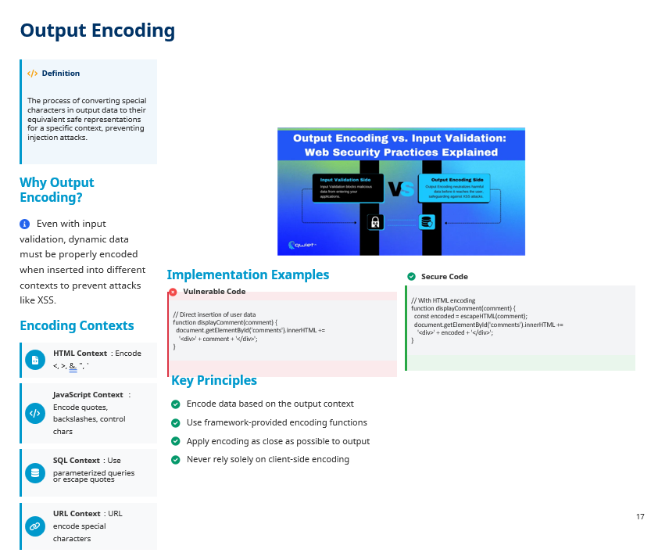

Slide 18

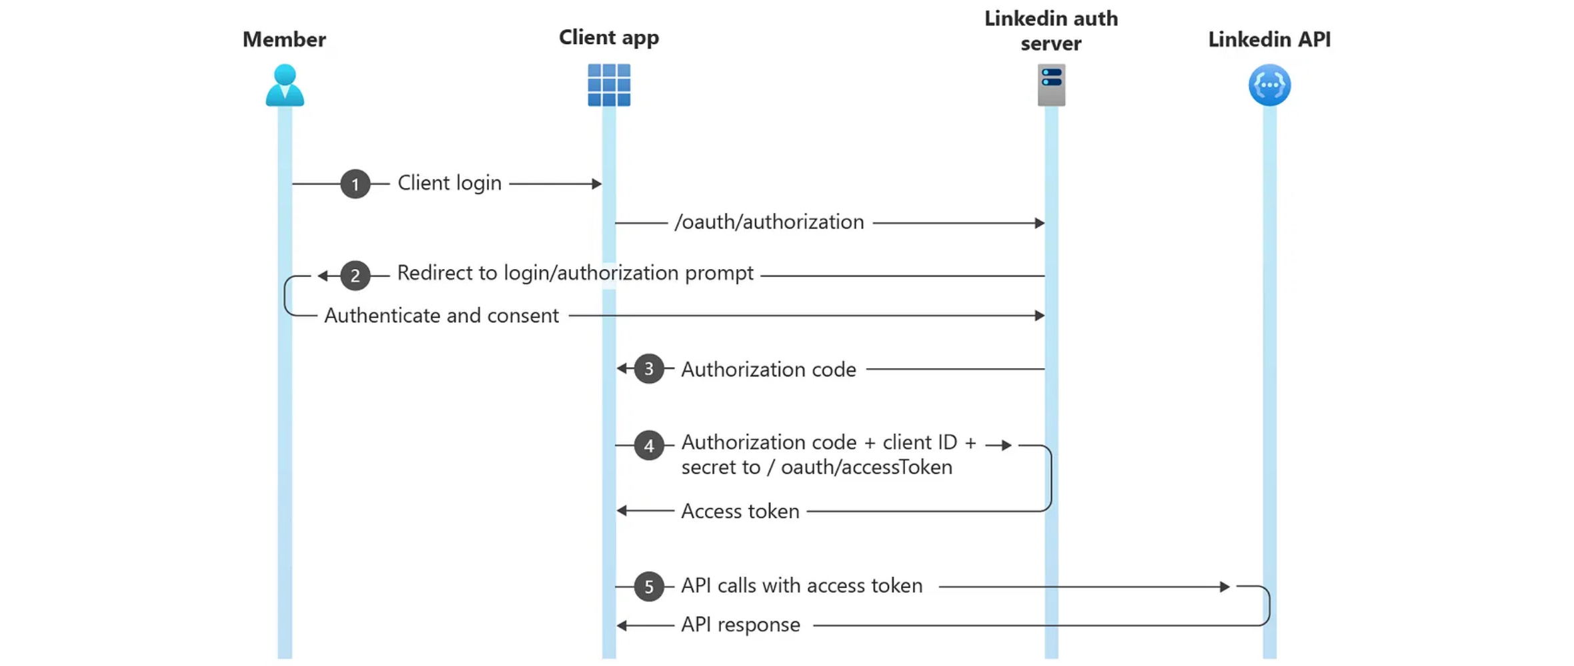








Secure Authentication
Definition
The process of verifying the identity of a user, system, or entity through secure mechanisms that protect against unauthorized access.
Authentication Factors
Best Practices
Something you know
: Passwords, PINs, security questions
Something you have
: Mobile devices, smart cards, tokens
Multi-Factor Authentication (MFA)
: Require at least two factors
Something you are
: Biometrics (fingerprint, face, voice)
Somewhere you are
: Location-based authentication
Secure Password Storage
: Use strong adaptive hashing (bcrypt,
Common Pitfalls
Argon2)
Rate Limiting
: Limit authentication attempts to prevent brute force
Weak Password Policies
: Allowing simple, common passwords
OAuth 2.0 & OpenID Connect
: Use standard protocols for
Credential Storage
: Storing passwords in plaintext or weak
hashing
authentication
Secure Session Management
: Use secure, HttpOnly, SameSite
Brute Force Vulnerability
: No rate limiting or account lockout
cookies
18

Slide 19

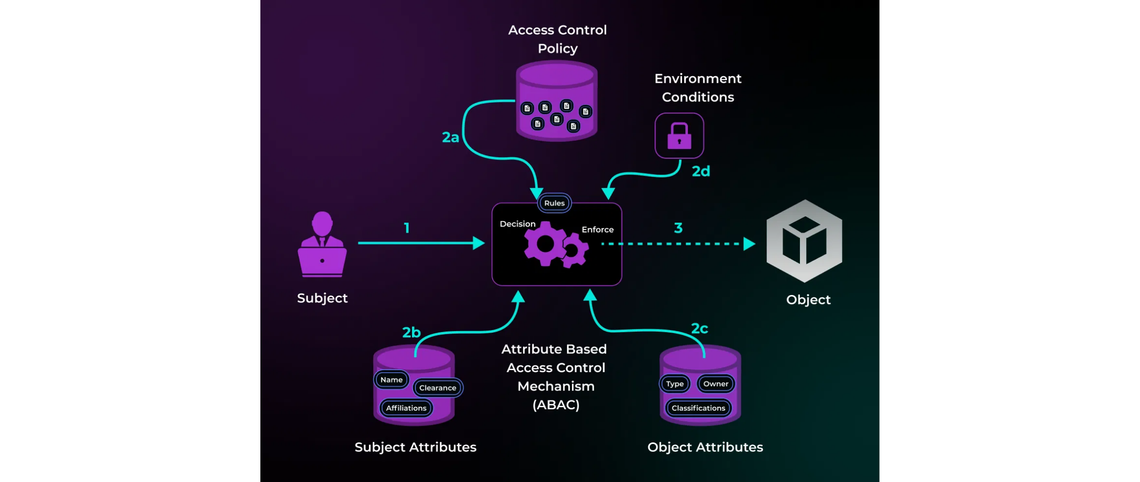





Access Control
Definition
The process of restricting access to resources based on the identity of users and their associated privileges, ensuring that users can only access what they are authorized to.
Access Control Models
Discretionary Access Control (DAC)
Access rights based on the identity of users and/or groups. Resource owners decide who can access their resources.
Common Vulnerabilities
Mandatory Access Control (MAC)
: Exposing internal implementation objects
Access based on sensitivity labels assigned to users and resources. System enforces policy regardless of user actions.
Insecure Direct Object References
: Not enforcing authorization at function level
Missing Function Level Access Control
Role-Based Access Control (RBAC)
Access rights assigned to roles, and users are assigned to appropriate roles. Simplifies management for large organizations.
: Accessing other users' resources
Horizontal Privilege Escalation
: Gaining higher privileges than authorized
Attribute-Based Access Control (ABAC)
Vertical Privilege Escalation
Access decisions based on attributes of users, resources, actions, and environment. Highly flexible and context-aware.
Best Practices
: Start with no access, then explicitly grant permissions
Deny by Default
: Implement access control in a single, well-tested component
Centralized Mechanism
Least Privilege
: Grant minimal access required for functionality
Re-authenticate
: Require confirmation for sensitive operations
19

Slide 20
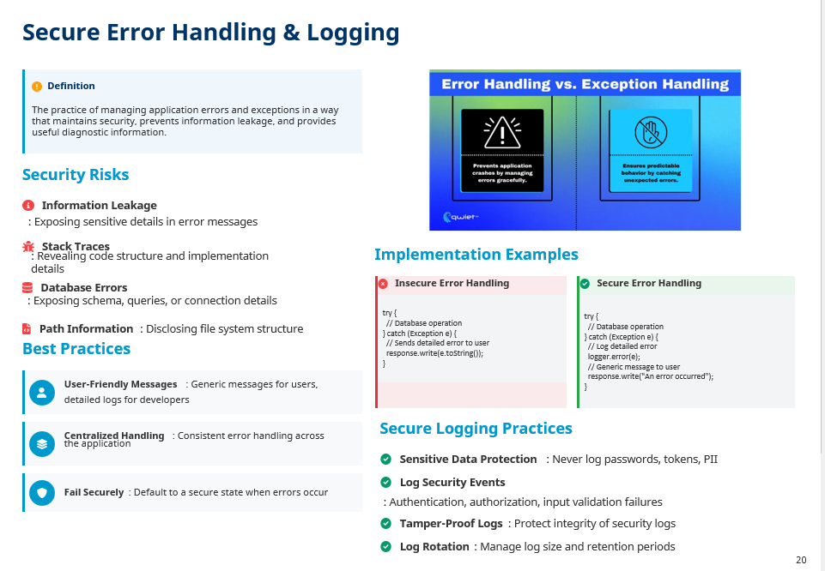

Slide 21





Cryptography in Secure Software
Best Practices
Use Standard Libraries
: Rely on well-tested implementations
Definition
The practice of securing information by transforming it into an unreadable format for unauthorized users, while allowing authorized users to access the original information.
Keep Up-to-Date
: Follow cryptographic standards and updates
Secure Key Management
: Protect keys throughout their lifecycle
Core Cryptographic Services
Common Pitfalls
Confidentiality
Protecting data from unauthorized access using encryption
Custom Cryptography
: Creating proprietary algorithms instead of
using standard ones
Integrity
Ensuring data has not been altered using hashing and digital signatures
Poor Key Management
: Hardcoding keys, weak key generation, or
improper storage
Authentication
Weak Randomness
: Using predictable random number generators
Verifying the identity of parties using digital signatures and MACs
Non-repudiation
Outdated Algorithms
: Using deprecated or broken cryptographic
methods
Preventing denial of actions using digital signatures
21

Slide 22

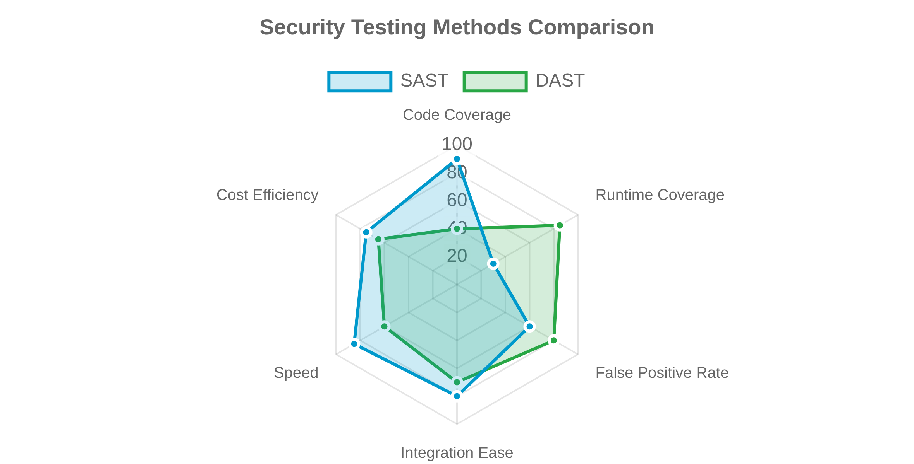



Security Testing in Design & Development
Definition
The process of evaluating software for security vulnerabilities through various testing methodologies throughout the development lifecycle.
Testing Methodologies
Static Application Security Testing (SAST)
Analyzes source code for vulnerabilities without executing the application.
Manual Testing Approaches
Penetration Testing
Dynamic Application Security Testing (DAST)
Simulated attacks by security professionals to identify vulnerabilities.
Tests running applications by simulating attacks from the outside.
Software Composition Analysis (SCA)
Code Review
Identifies vulnerabilities in third-party and open-source components.
Manual examination of source code by security experts.
Integration with SDLC
Shift Left
: Integrate security testing early in development
Continuous Testing
: Automate security tests in CI/CD pipelines
22

Slide 23

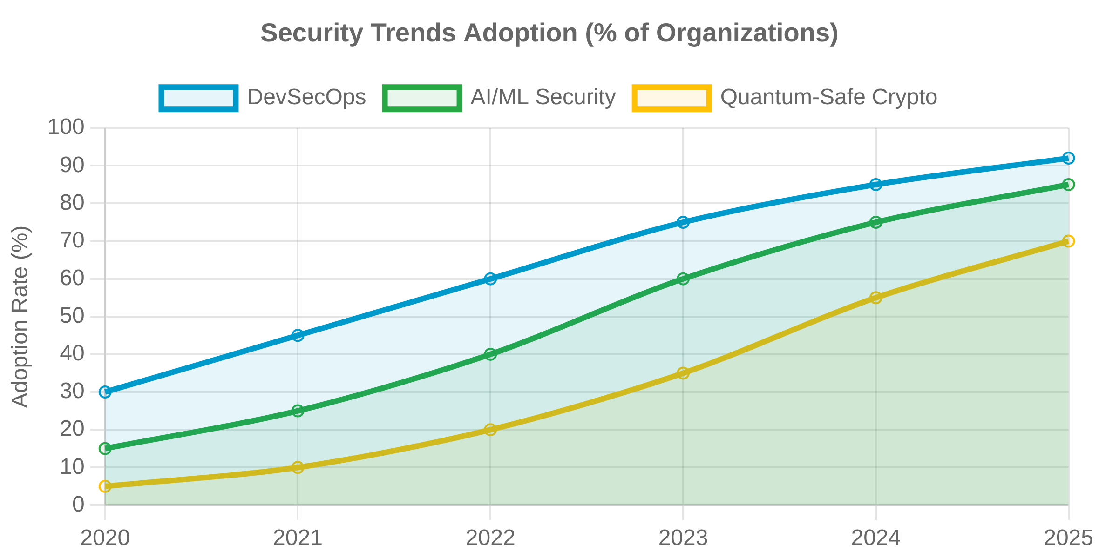





Emerging Topics & Future Trends
Looking Forward
As technology evolves, secure software engineering must adapt to new challenges and opportunities in the security landscape.
AI & ML in Security
Automated Vulnerability Detection
Using ML to identify patterns and predict potential vulnerabilities in code.
Intelligent Threat Monitoring
AI-powered systems that adapt to evolving threats in real-time.
Quantum Computing Impact
DevSecOps Integration
Post-Quantum Cryptography
Security as Code
Developing cryptographic systems resistant to quantum computing attacks.
Implementing security controls through code and infrastructure definitions.
Human Factors
Security Culture & Awareness
Integrating human behavior understanding into security design.
Usable Security
Designing security that works with, not against, human behavior.
23

Slide 24

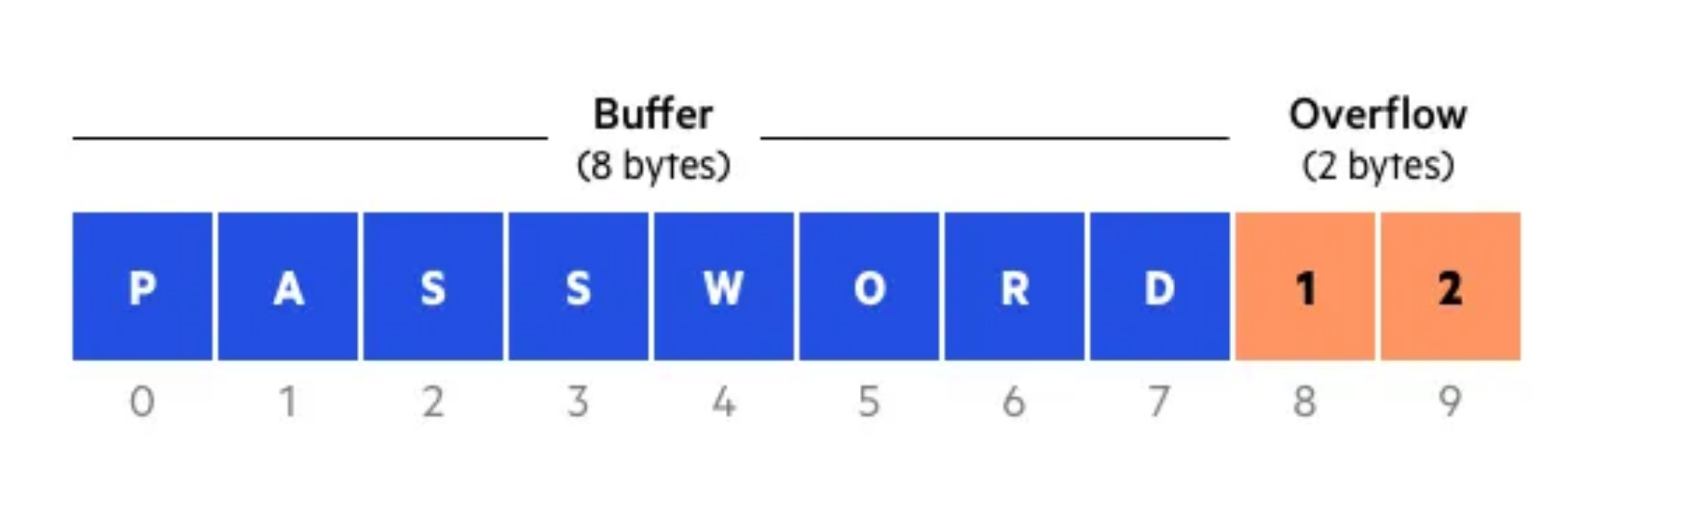





Advanced Secure Coding: Memory Safety
Concept
Memory safety ensures that memory access operations are valid and do not lead to undefined behavior, preventing a class of critical vulnerabilities.
Memory Corruption Vulnerabilities
Buffer Overflows
: Writing data beyond the allocated buffer,
overwriting adjacent memory.
Secure Coding Techniques
Use-After-Free
: Accessing memory after it has been freed, leading
Memory-Safe Languages
: Using languages like Rust, Go, or
to unpredictable behavior.
modern C++ features.
Double-Free
: Attempting to free the same memory block twice,
Bounds Checking
: Ensuring array and buffer accesses are within
corrupting memory management structures.
their defined boundaries.
Integer Overflows/Underflows
: Arithmetic operations resulting in
Memory Sanitizers
: Tools like AddressSanitizer (ASan) to detect
values outside the representable range, leading to unexpected
memory errors at runtime.
behavior.
Secure String Handling
: Using safe string functions and libraries.
25

Slide 25

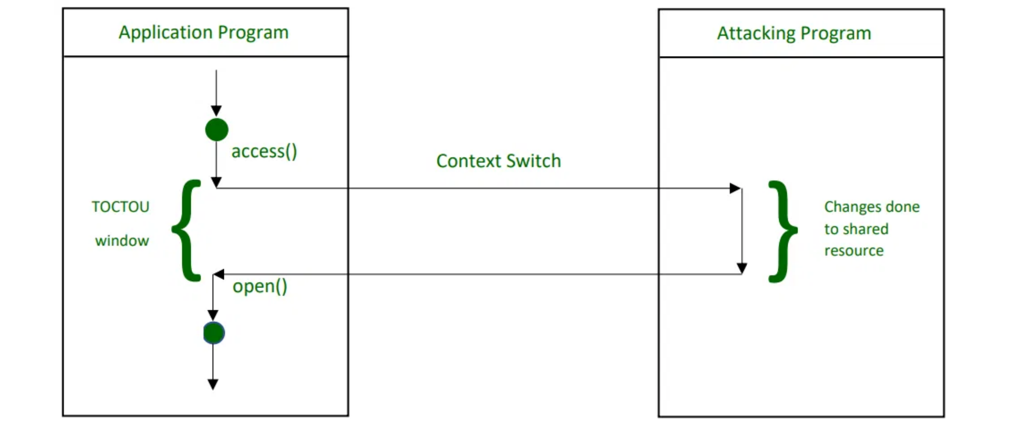





Advanced Secure Coding: Concurrency Issues
Concept
Concurrency issues arise when multiple threads or processes access shared resources simultaneously, leading to unpredictable behavior and potential security vulnerabilities.
Common Concurrency Vulnerabilities
Race Conditions
: When the outcome of an operation depends on
the unpredictable sequence or timing of other events.
Secure Concurrency Techniques
Deadlocks
: A situation where two or more competing actions are
each waiting for the other to finish, and thus neither ever does.
Synchronization Primitives
locks to control access to shared resources.
: Using mutexes, semaphores, and
Time-of-Check to Time-of-Use (TOCTOU)
: A race condition where a
program checks the state of a resource before using it, but the state
changes between the check and the use.
Atomic Operations
: Operations that are guaranteed to complete
without interruption from other threads.
Immutable Data Structures
cannot be modified after creation, eliminating race conditions.
: Designing data structures that
Thread-Safe Libraries
for concurrent environments.
: Using libraries and frameworks designed
26

Slide 26





Advanced Secure Coding: Input Validation Deep Dive
Importance
Regular Expressions: Best Practices & Pitfalls
Input validation is paramount for security, preventing various attacks by ensuring all input data conforms to expected formats and ranges before processing.
Use strong, specific regex patterns for validation.
Beware of ReDoS (Regular Expression Denial of Service) vulnerabilities.
Context-Aware Validation
HTML Context
// Example: Validating email format
const emailRegex = /^[a-zA-Z0-9._%+-]+@[a-zA-Z0-9.-]+\.[a-zA-Z]{2,}$/;
if (!emailRegex.test(inputEmail)) {
// Handle invalid email
}
Preventing XSS by validating and sanitizing input for HTML output.
SQL Context
Preventing SQL Injection by validating input before database queries.
Validation Frameworks & Libraries
Utilize established libraries like OWASP ESAPI, Apache Commons
JSON/XML Context
Validator, or built-in framework validators.
Ensuring data integrity and preventing parsing vulnerabilities in structured data.
These provide pre-built, tested, and secure validation routines for
common data types.
27

Slide 27









Advanced Secure Coding: Output Encoding Deep Dive
Purpose
Using Robust Encoding Libraries
Output encoding converts untrusted input into a safe form for the intended output context, preventing injection attacks like XSS.
Rely on well-vetted libraries like OWASP ESAPI or AntiSamy for
comprehensive encoding.
Encoding for Different Contexts
These libraries handle complex encoding rules for various contexts,
reducing the risk of errors.
HTML Context
Encode special characters (<, >, ", ", &) to prevent HTML injection and XSS.
// Example: HTML encoding using a library
String untrustedInput = "
";
String encodedOutput = ESAPI.encoder().encodeForHTML(untrustedInput);
// Output: <script>alert('XSS')</script>
JavaScript Context
Encode non-alphanumeric characters to prevent JavaScript injection.
Common Encoding Mistakes
URL Context
Encoding once and using in multiple contexts (e.g., HTML encoded
URL encode parameters to prevent URL manipulation and path traversal.
string used in JavaScript).
Not encoding at all, leading to direct injection vulnerabilities.
CSS Context
Using blacklisting instead of whitelisting for encoding, which is prone
Encode input used in CSS to prevent CSS injection and XSS.
to bypasses.
28

Slide 28






Advanced Security Testing: Fuzzing
What is Fuzzing?
Fuzzing (or fuzz testing) is an automated software testing technique that involves injecting malformed or unexpected inputs into a program to discover software bugs and security vulnerabilities.
Popular Fuzzing Tools
Types of Fuzzing
AFL (American Fuzzy Lop)
Mutation-based Fuzzing
A powerful, open-source, coverage-guided fuzzer.
Modifies existing valid inputs by randomly changing bits, bytes, or blocks of data.
Peach Fuzzer
A comprehensive fuzzer that uses XML-based Peach Pit files to define data structures.
Generation-based Fuzzing
Generates new inputs from scratch based on a model or specification of the input format.
LibFuzzer
A library for in-process, coverage-guided fuzzing, often integrated into projects.
Coverage-guided Fuzzing
Uses code coverage feedback to guide the generation of new inputs, aiming to explore more code paths.
29

Slide 29






Advanced Security Testing: Red & Blue Teaming
Concept
Red Teaming simulates real-world attacks to test an organization's defenses, while Blue Teaming focuses on defending against and responding to these attacks.
Red Teaming
Simulated Adversaries
Purple Teaming
Acts as an attacker, using realistic tactics, techniques, and procedures (TTPs) to bypass security controls.
Collaboration & Feedback
Objective-Based
Red and Blue teams work together, sharing insights and feedback to enhance overall security effectiveness.
Focuses on achieving specific objectives, such as data exfiltration or system compromise, rather than just finding vulnerabilities.
Improves defensive capabilities by understanding attacker
Blue Teaming
methodologies.
Provides realistic assessment of security posture.
Defensive Operations
Responsible for maintaining the organization's security posture, detecting, and responding to attacks.
Monitoring & Response
Involves security monitoring, incident response, and continuous improvement of defensive capabilities.
30

Slide 30




Secure Software Deployment: CI/CD Pipeline Security
Concept
Securing the CI/CD pipeline involves integrating security practices and tools throughout the automated software delivery process to prevent vulnerabilities from reaching production.
Security at Each Stage
Key Practices
Source Code Stage
Automate security checks: Integrate SAST, DAST, SCA into
Secure coding guidelines, static analysis (SAST), secret scanning, dependency scanning (SCA).
CI/CD.
Secrets Management: Use secure vaults (e.g., HashiCorp
Build Stage
Vault, AWS Secrets Manager) for credentials.
Secure build configurations, integrity checks, trusted build environments.
Immutable Infrastructure: Deploy new, secure
environments rather than patching existing ones.
Test Stage
Dynamic analysis (DAST), interactive analysis (IAST), penetration testing, security unit/integration tests.
Least Privilege: Apply least privilege to CI/CD tools and
service accounts.
Deployment Stage
Secure configuration management, infrastructure as code (IaC) security, secrets management, runtime protection (RASP).
31

Slide 31


Secure Software Deployment: Container & Orchestration Security
Containers & Security
Containers provide portability and efficiency, but introduce new security considerations related to image integrity, runtime isolation, and orchestration management.
Runtime Container Security
Container Isolation
Container Image Security
Utilize namespaces, cgroups, and seccomp profiles for strong isolation.
Vulnerability Scanning
Least Privilege
Scan container images for known vulnerabilities before deployment (e.g., Clair, Trivy).
Run containers with non-root users and minimal necessary capabilities.
Minimal Images
Orchestration Security (e.g., Kubernetes)
Use minimal base images (e.g., Alpine Linux) to reduce attack surface.
Network Policies
Control traffic flow between pods and namespaces.
Image Signing & Trust
Ensure images come from trusted sources and are cryptographically signed.
Secrets Management
Securely manage sensitive information using Kubernetes Secrets or external vaults.
32

Slide 32








Security Governance and Compliance
Overview
Security governance establishes the framework for managing security risks, while compliance ensures adherence to relevant laws, regulations, and standards.
Establishing Security Policies & Procedures
Key Regulations and Standards
Develop clear security policies that align with business
GDPR (General Data Protection Regulation)
objectives and regulatory requirements.
Protects personal data and privacy for individuals within the EU and EEA.
Implement detailed procedures for secure development,
operations, and incident response.
HIPAA (Health Insurance Portability and Accountability Act)
Sets standards for protecting sensitive patient health information in the U.S.
Auditing and Reporting
Regularly audit security controls and processes to ensure
ISO 27001
effectiveness and compliance.
International standard for information security management systems (ISMS).
Generate reports for stakeholders and regulatory bodies,
demonstrating due diligence and continuous improvement.
NIST Cybersecurity Framework
Voluntary framework for organizations to manage and reduce cybersecurity risk.
33

Slide 33








Incident Response and Forensics in SSE
Importance
Effective incident response and digital forensics are crucial for minimizing damage, recovering from security breaches, and learning from incidents to improve future security posture.
Incident Response Lifecycle
Preparation
Digital Forensics Basics for Software Incidents
Developing policies, procedures, and teams; conducting training and drills.
Data Collection
: Securely acquiring volatile and persistent
data (memory, disk images, logs).
Identification
Analysis
: Examining collected data to identify attack vectors,
Detecting security events and determining if an incident has occurred.
malware, and attacker activities.
Reporting
: Documenting findings for legal, compliance, and
Containment
internal improvement purposes.
Limiting the scope and impact of the incident; preventing further damage.
Chain of Custody
: Maintaining a strict record of evidence
handling to ensure its admissibility.
Eradication
Removing the root cause of the incident and any malicious components.
Recovery
Restoring affected systems and services to normal operation.
34

Slide 34




Future of SSE: AI/ML in Security
Transformative Potential
Artificial Intelligence and Machine Learning are revolutionizing cybersecurity by enhancing threat detection, vulnerability management, and automated response capabilities.
AI/ML for Automated Vulnerability Discovery & Patching
AI/ML for Threat Detection & Anomaly Analysis
Automated Fuzzing & Exploit Generation
AI-driven fuzzers can intelligently generate test cases to uncover vulnerabilities more efficiently.
Behavioral Analytics
Identifying deviations from normal user and system behavior to detect insider threats and advanced persistent threats (APTs).
Automated Patch Generation
Research into AI systems that can automatically generate code patches for identified vulnerabilities.
Network Anomaly Detection
Analyzing network traffic patterns to spot malicious activities, malware communication, and data exfiltration attempts.
Ethical Considerations & Challenges
Bias in AI models leading to unfair or ineffective security
Malware Analysis
decisions.
Automated classification and detection of new and evolving malware variants.
Adversarial AI: Attackers using AI to bypass defenses or
generate new attacks.
35

